Slide 1
3.1 Operating & Financial Leverage

Slide 2
Leverage
Leverage refers to the use of an asset or source of funds which involves fixed costs or fixed returns. As a result, the earnings available to the shareholders/owners are affected as also their risk. There are three types of leverage, namely,
Operating
Financial
Combined

Slide 3
Operating Leverage
Leverage associated with asset acquisition or investment activities is referred to as the operating leverage. It refers to the firm’s ability to use fixed operating costs to magnify the effect of changes in sales on its operating profits (EBIT) and results in more than a proportionate change (±) in EBIT with change in the sales revenue.
Degree of operating leverage (DOL) is computed in two ways:
Percentage change in EBIT/Percentage change in sales and
(Sales – Variable costs)/EBIT.

Slide 4
Operating Leverage
The operating leverage is favourable when increase in sales volume has a positive magnifying effect on EBIT. It is unfavourable when a decrease in sales volume has a negative magnifying effect on EBIT. Therefore, high DOL is good when sales revenues are rising and bad when they are falling.
The DOL is a measure of the business/operating risk of the firm. Operating risk is the risk of the firm not being able to cover its fixed operating costs. The larger is the magnitude of such costs, the larger is the volume of sales required to recover them. Thus, the DOL depends on fixed operating costs.

Slide 5
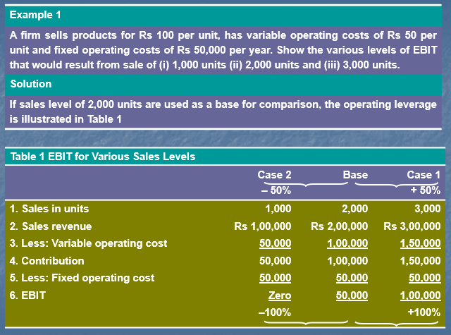

Slide 6
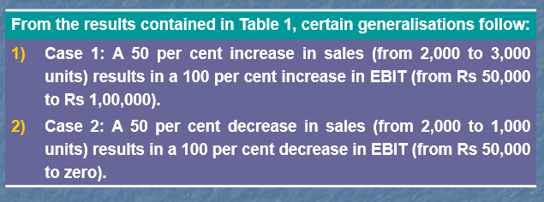

Slide 7
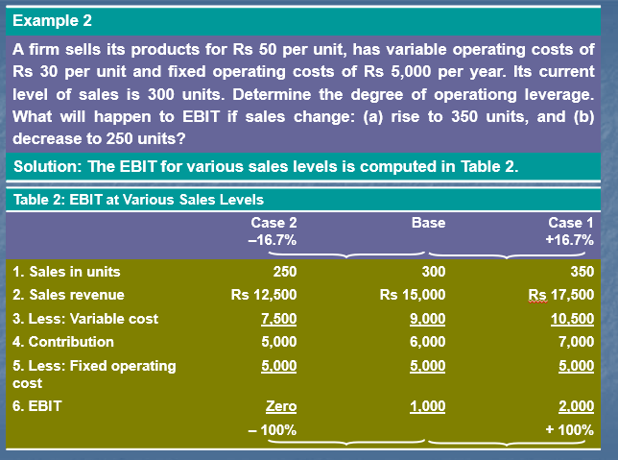

Slide 8
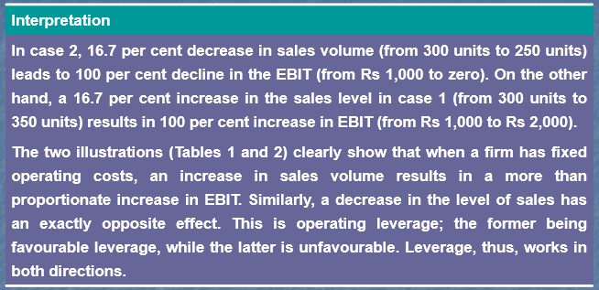

Slide 9
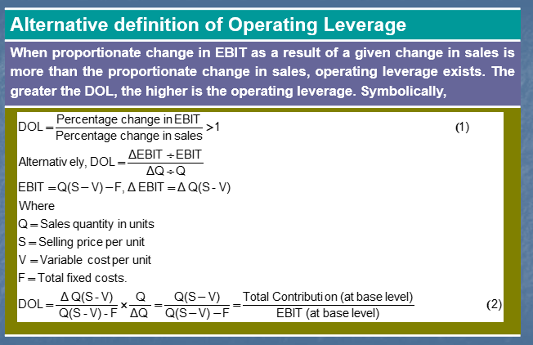

Slide 10
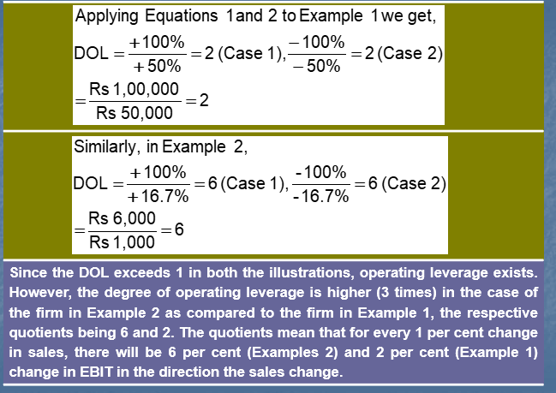

Slide 11
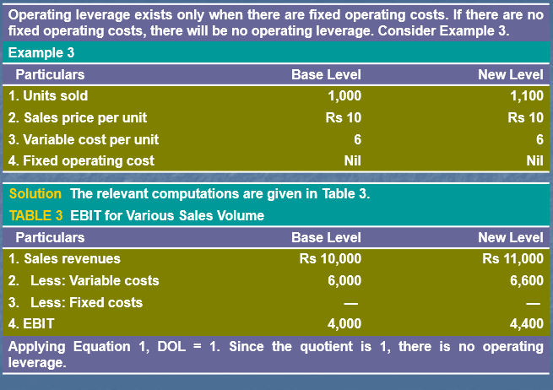

Slide 12
Financial Leverage
Financial leverage is related to the financing activities of a firm. It results from the presence of fixed financial charges (such as interest on debt and dividend on preference shares). Since such financial expenses do not vary with the operating profits, financial leverage is concerned with the effect of changes in EBIT on the earnings available to equity-holders. It is defined as the ability of a firm to use fixed financial charges to magnify the effect of changes in EBIT on the earnings per share (EPS).

Slide 13
Financial Leverage
Financial leverage involves the use of funds obtained at a fixed cost in the hope of increasing the return to the equity-holders. When a firm earns more on the assets purchased with the funds than the fixed cost of their use, the financial leverage is favourable. Unfavourable leverage occurs when the firm does not earn as much as the funds cost.
High fixed financial costs increase the financial leverage and, thus, financial risk. The financial risk refers to the risk of the firm not being able to cover its fixed financial costs. In case of default, the firm can be technically forced into liquidation. The larger is the amount of fixed financial costs, the larger is EBIT required to recover them. Thus, the DFL depends on fixed financial costs.

Slide 14
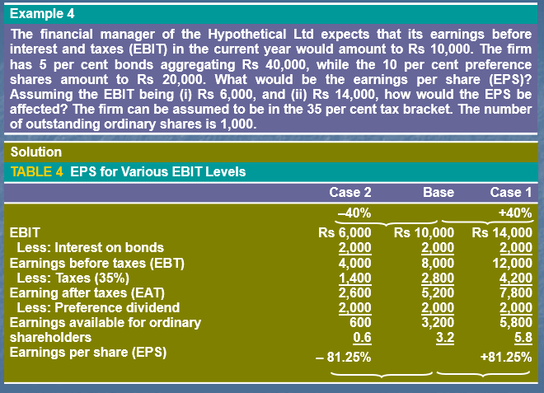

Slide 15
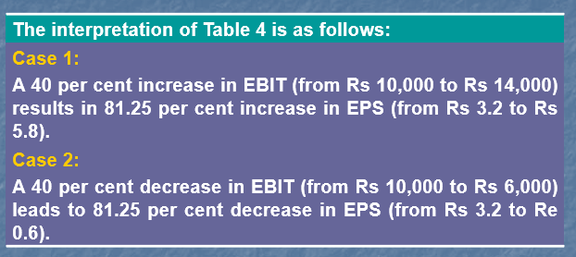

Slide 16
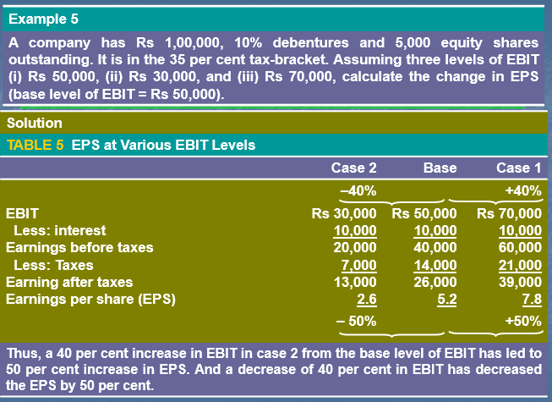

Slide 17
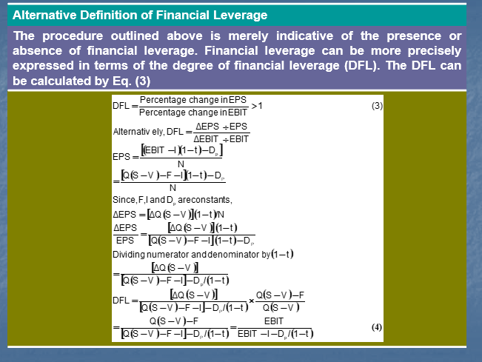

Slide 18
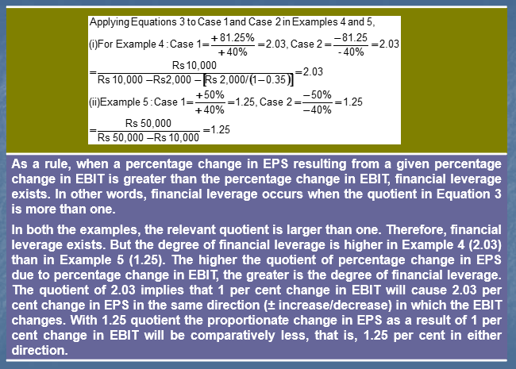

Slide 19
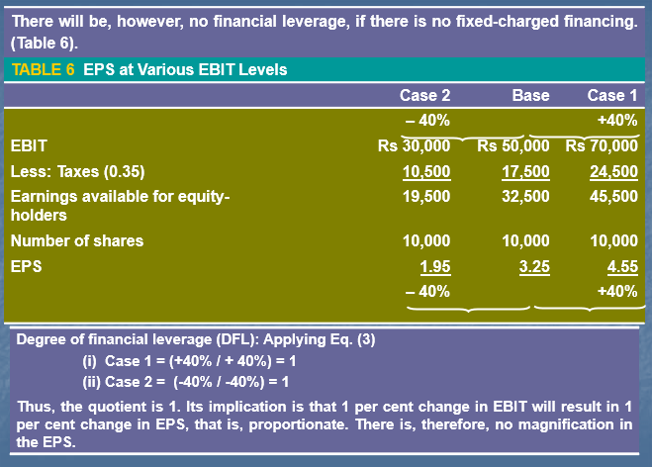

Slide 20
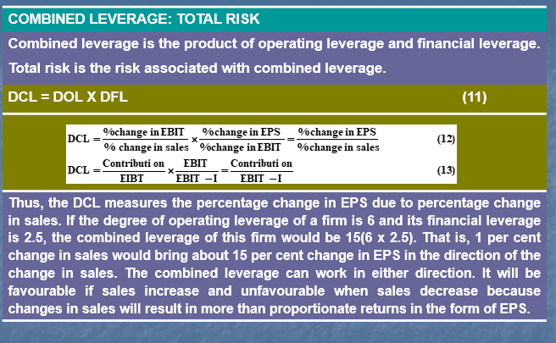

Slide 21
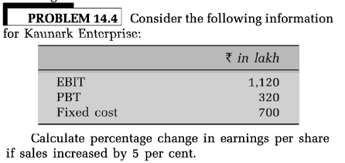

Slide 22
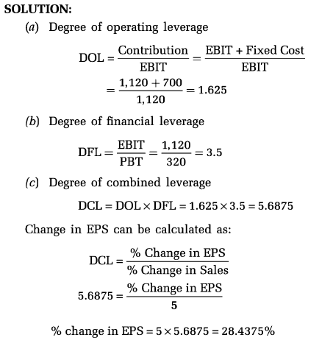

Slide 23
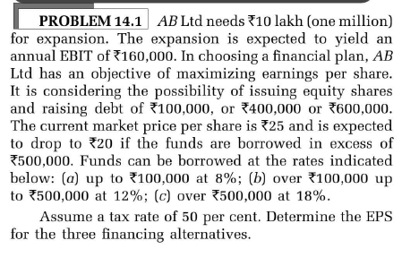

Slide 24
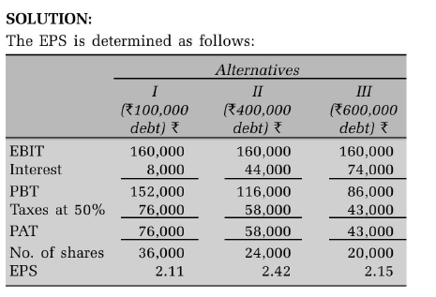
Solution

Slide 25
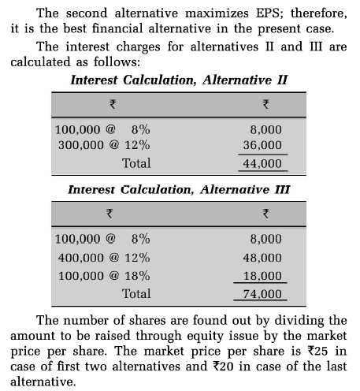

Slide 26
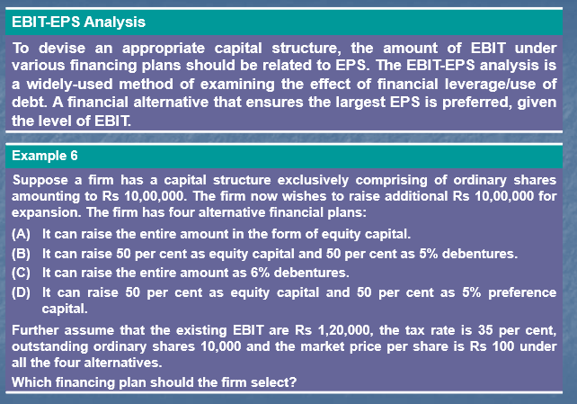

Slide 27
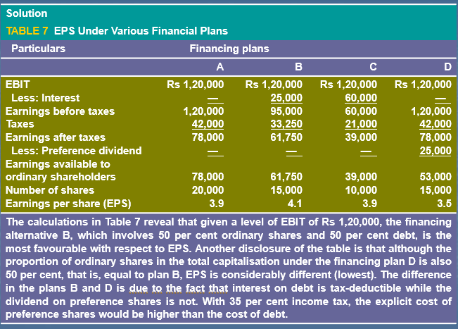

Slide 28
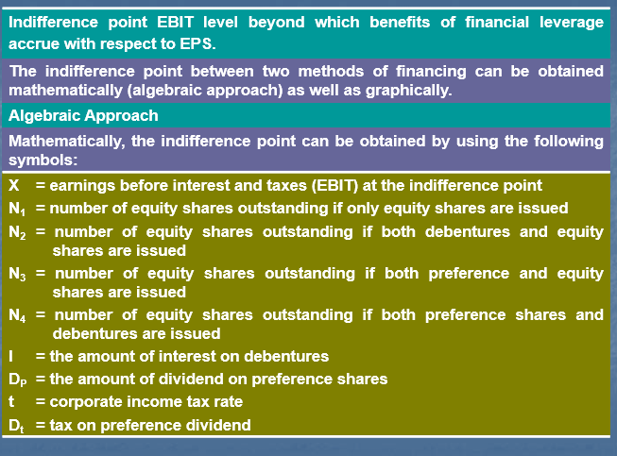

Slide 29
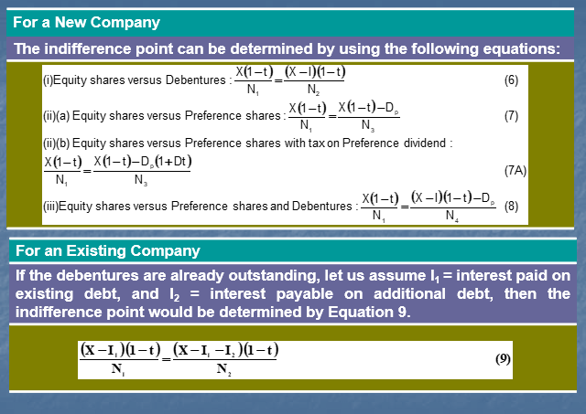

Slide 30
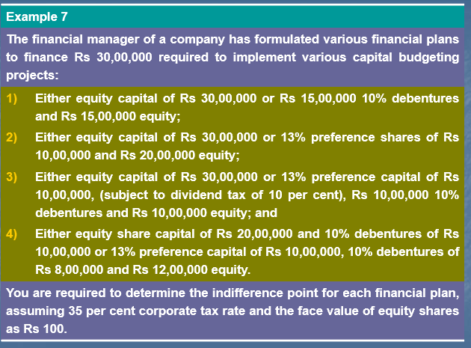

Slide 31
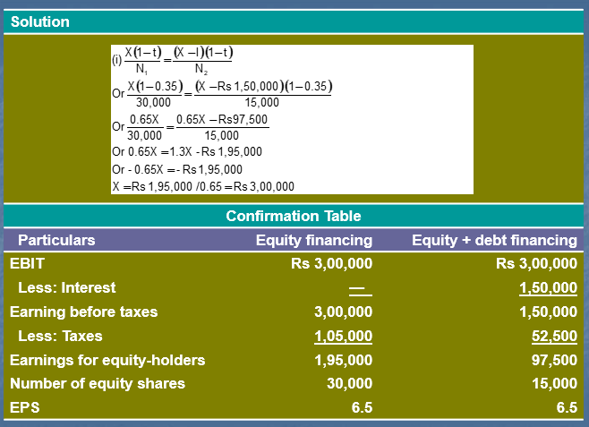

Slide 32
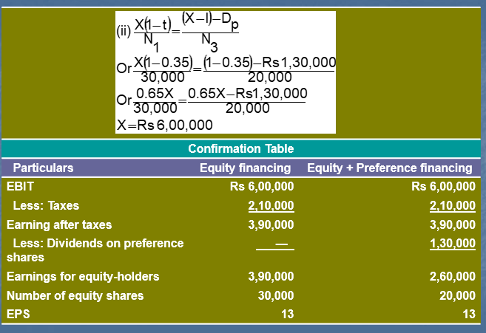

Slide 33
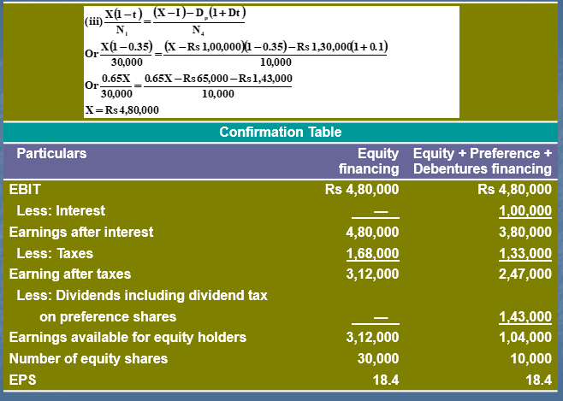

Slide 34
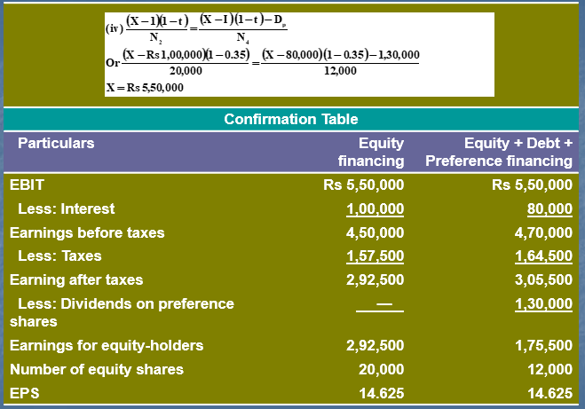

Slide 35
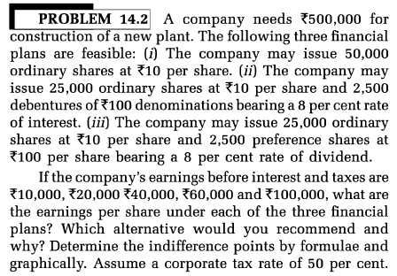

Slide 36
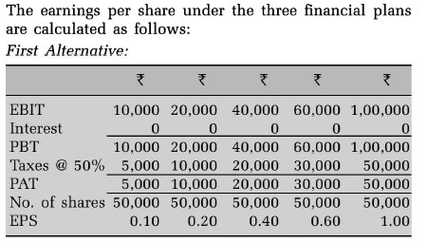

Slide 37
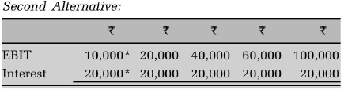
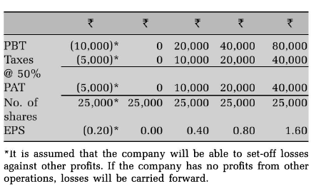

Slide 38
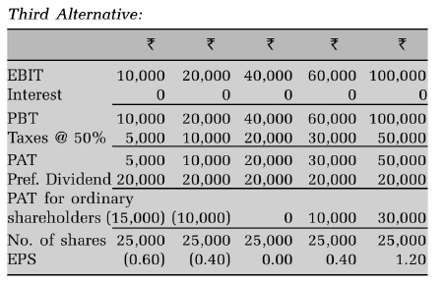

Slide 39
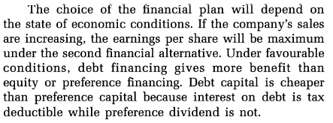

Slide 40
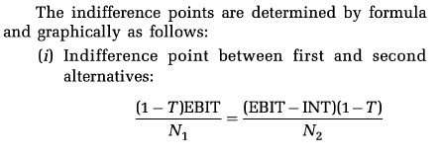
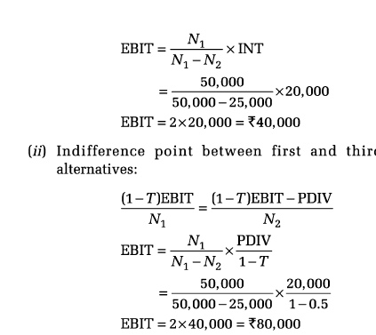

Slide 41
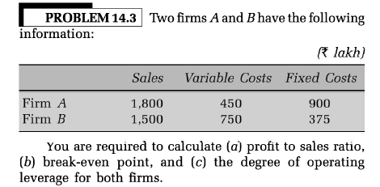

Slide 42
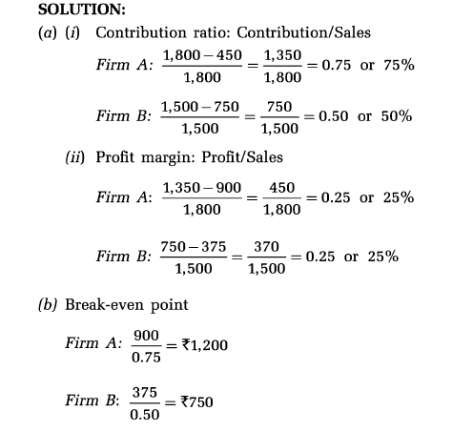

Slide 43



Slide 44


Slide 45
